Slide 1
CHIT-CHAT SOCIAL NETWORKING SITE
by
Nishant Jindal | Nikhil Singhal | Saurabh Singh | Yogesh Bhargav

Slide 2
WHAT IS SOCIAL MEDIA?
A social network is a website that allows people with similar interests to come together and share information, photos and videos.
A social network is defined as a chain of individuals and their personal connections

Slide 3

“Social media is not a media. The key is to listen, engage, and build relationships.” ~David Alston

Slide 4

WHAT IS CHIT-CHAT?
Chit-Chat is a social networking site which provide lots of facilities/features

Slide 5
FEATURES OF
CHIT-CHAT

Slide 6
1.
ADDING OR REMOVING FRIENDS
Chit-Chat let you add and remove friends from your account

Slide 7
2.
UPLOADING PROFILE PICTURE
Chit-Chat provide you an option to add your profile picture.

Slide 8
3.
UPLOADING COVER PHOTO
Chit-Chat let you upload cover photo on your acoount

Slide 9
4.
UPLOAD POST/PICTURE
You can even post or upload picture on your profile and someone else's profile

Slide 10
5.
COMMENT ON POST
You can comment on someone's post and reply to someone's else comment

Slide 11
6.
LIKE THE POST
User can like his own post and like anyone's else post

Slide 12
7.
SHOWS NUMBER OF FRIENDS AND POSTS
Number of posts and friends can be seenon user's profile

Slide 13
9.
UPDATE INFORMATION
User can upload its basic information on his profile

Slide 14
10.
PROVIDE NOTIFICATION COUNT
User will get notifications on notification menu

Slide 15
11.
OPTION TO SEARCH FOR PEOPLE
User can search for people they want to add

Slide 16
12.
OPTION TO DELETE YOUR ACCOUNT
User can also remove/delete his/her account

Slide 17
TECHNOLOGY USED
PHP
SQL
HTML
CSS
JAVASCRIPT
Bootstrap

Slide 18
USER INTERFACE

Slide 19
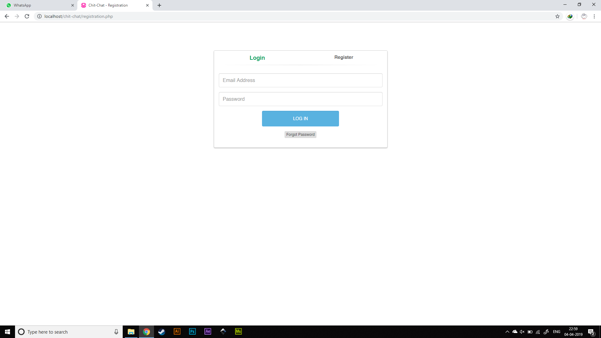

Slide 20
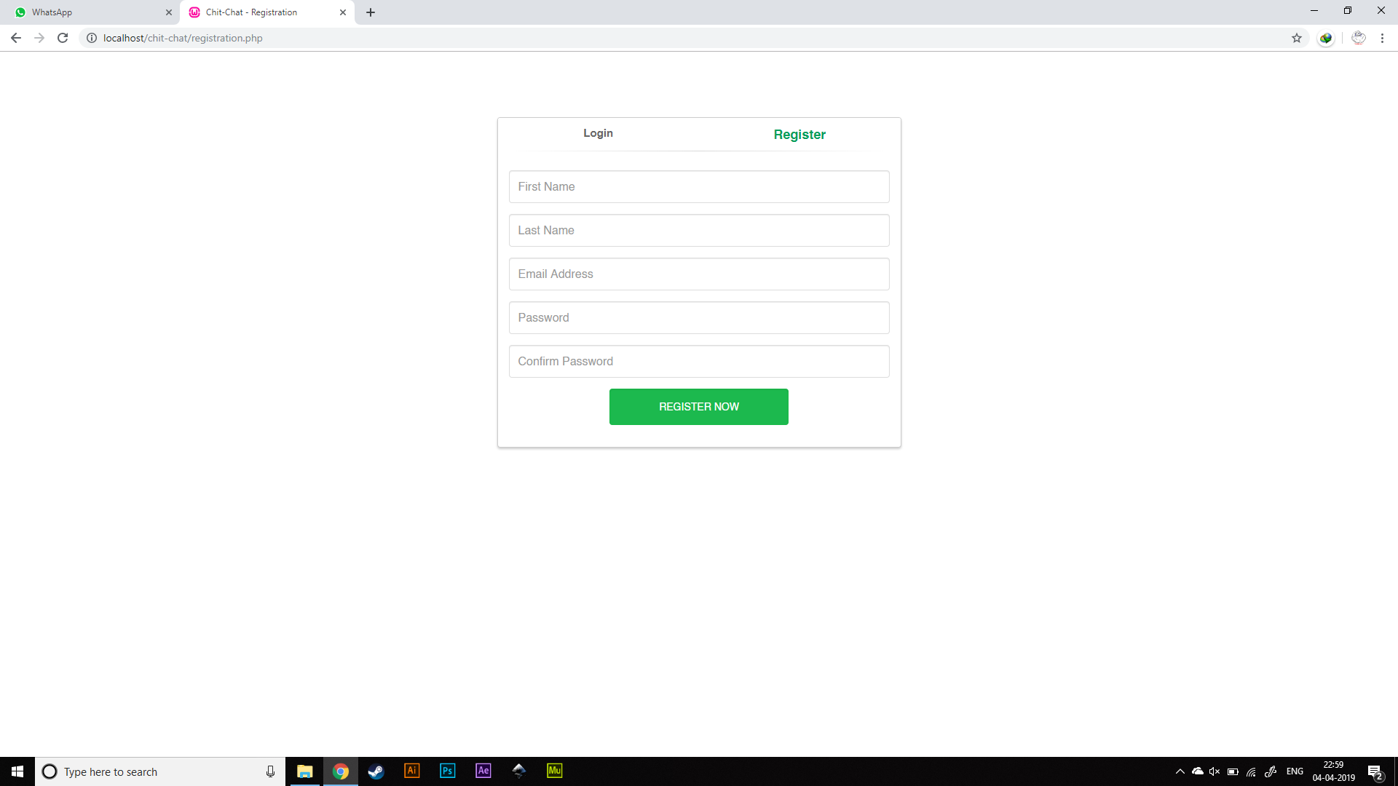

Slide 21
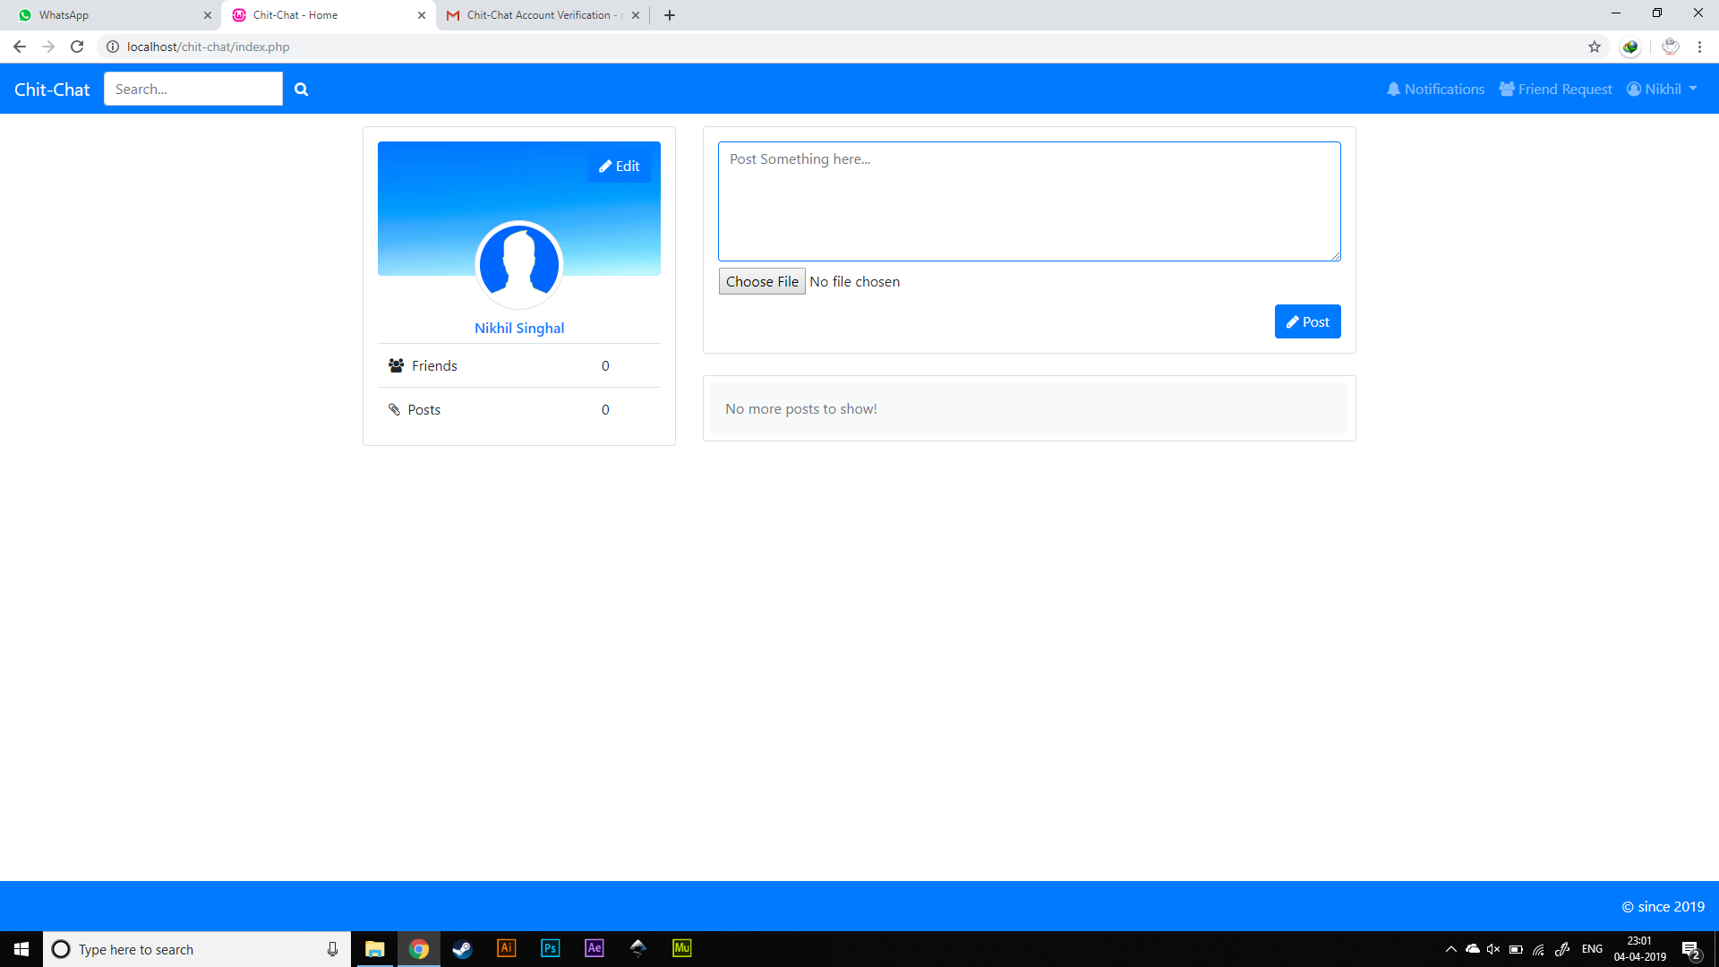

Slide 22
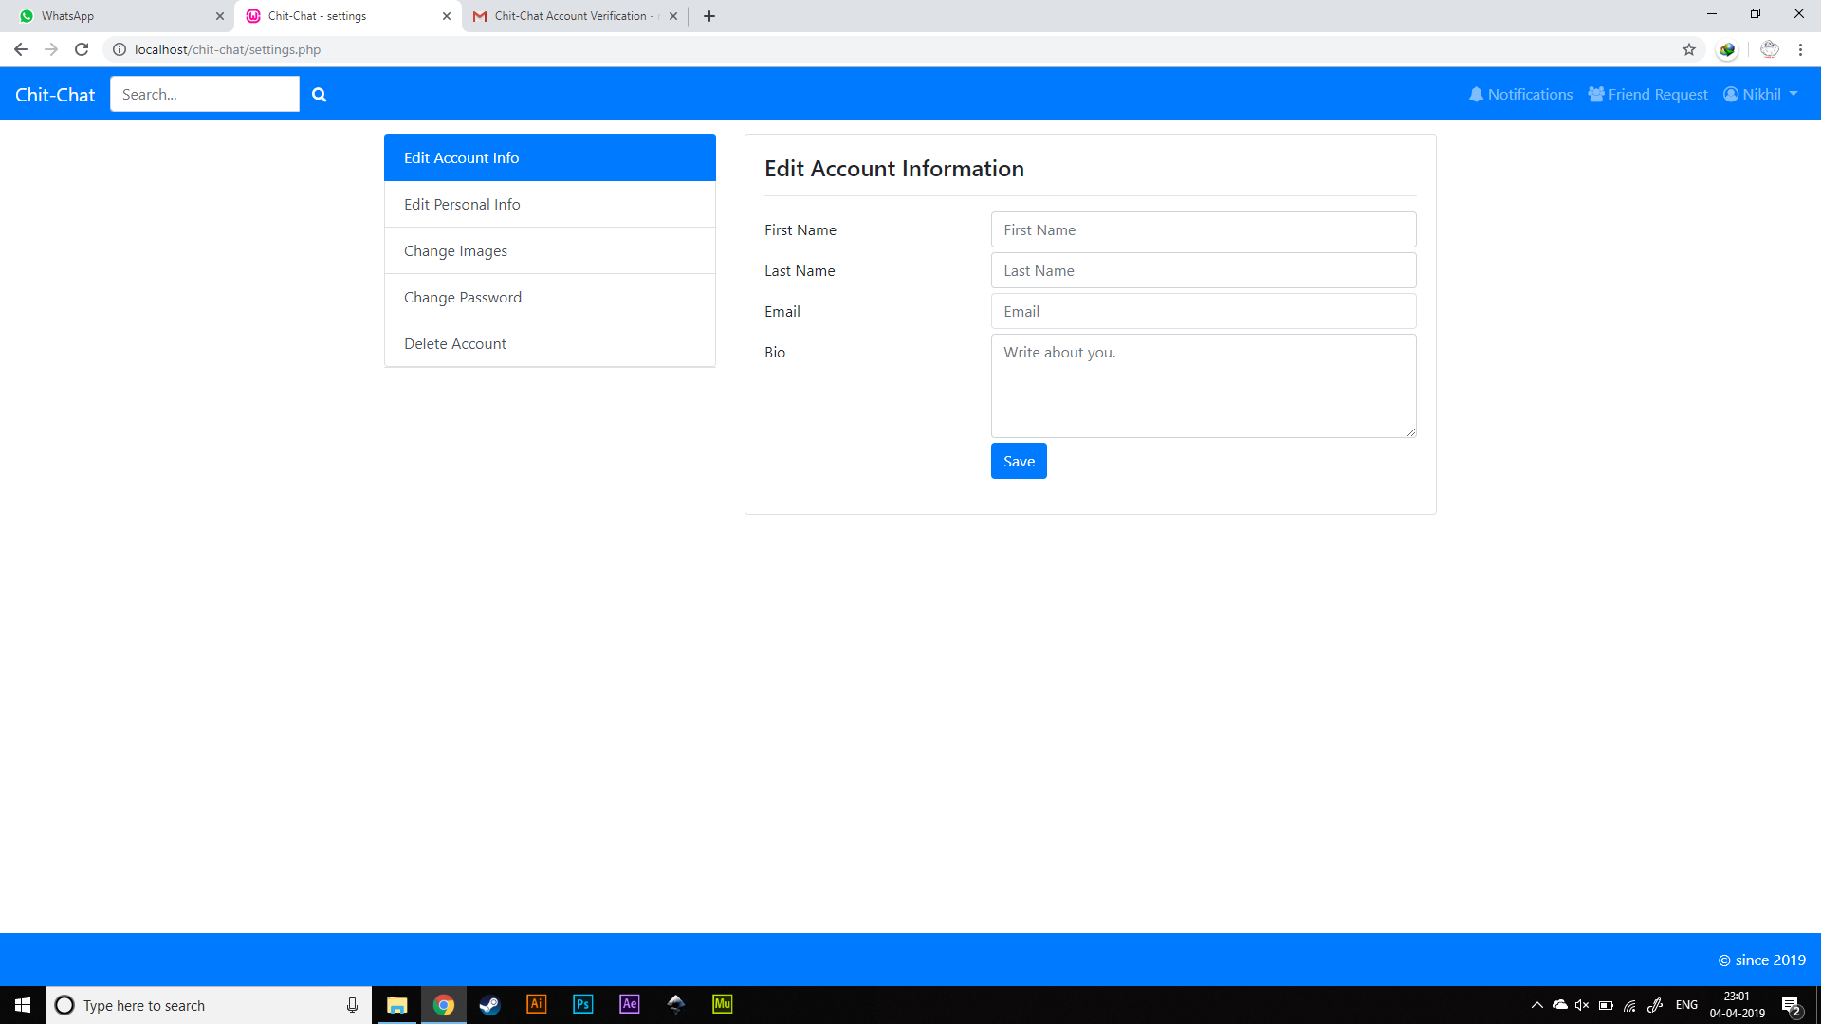

Slide 23
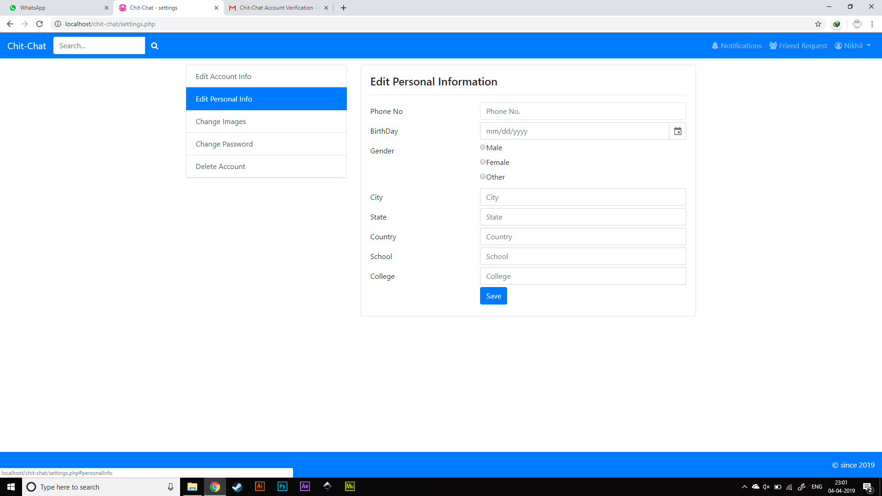

Slide 24
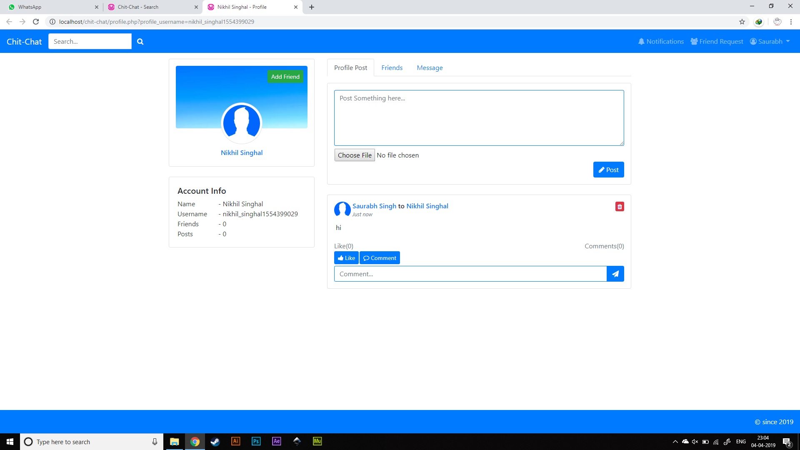

Slide 25
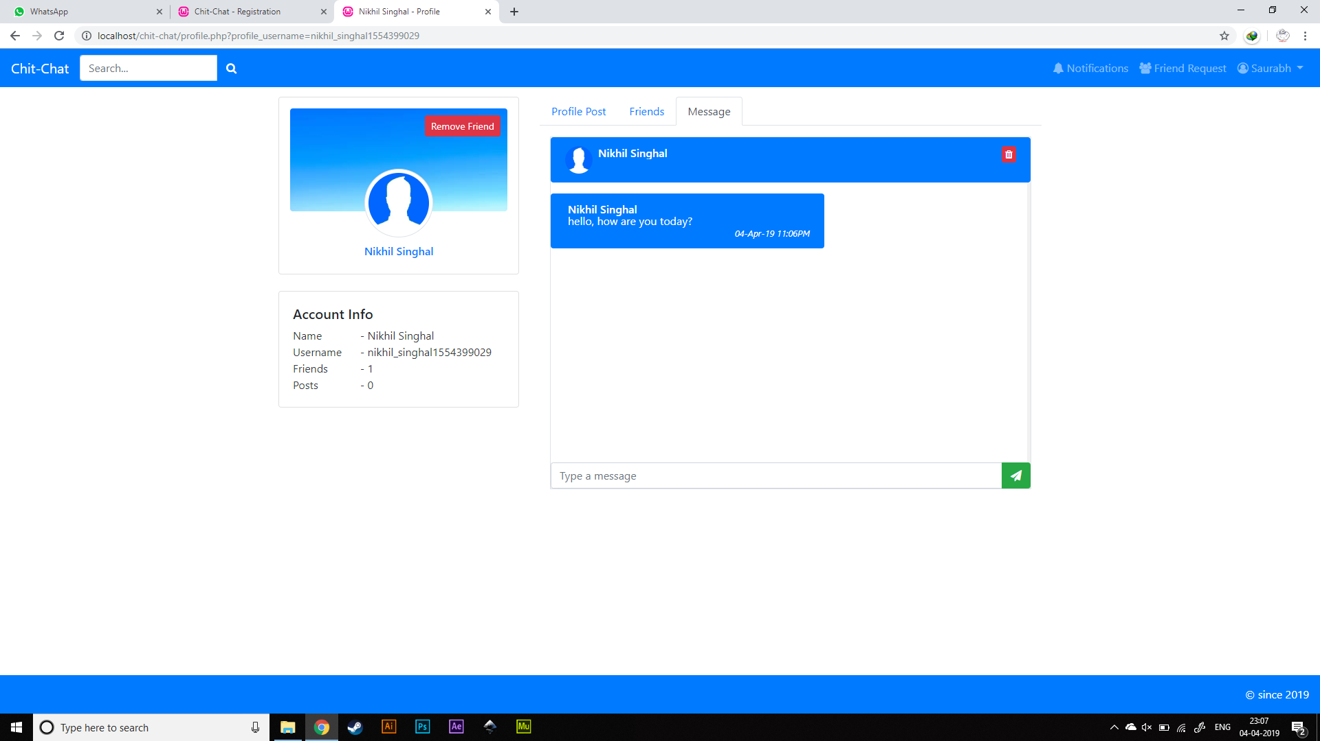

Slide 26
DATABASE TABLE

Slide 27
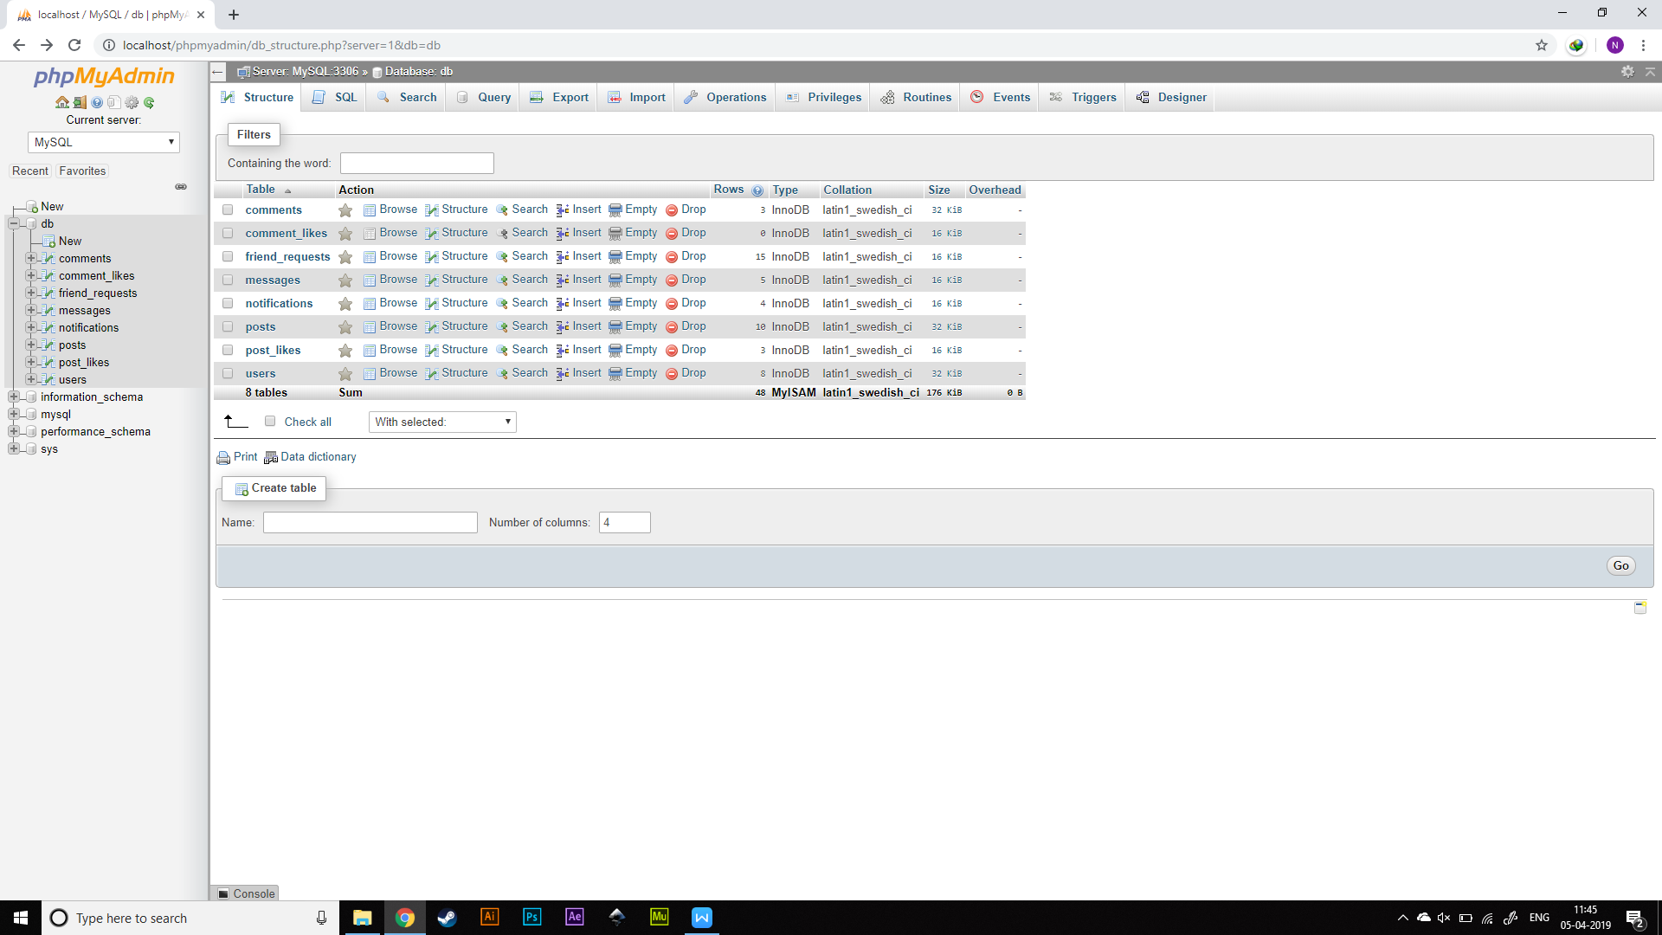

Slide 28
THANKS!

